Slide 1
AMSE Presentation
BY: UNT Robotics & Aerospace

Slide 2



Agenda
OVerview
DEMO
YOUR TURN
Quick explanation of what is needed
I’ll go over the material with an example
Ask the audience members with materials to build their own project

Slide 3



List of Needed Material(S)
Access to the Arduino IDE
Required
Arduino MEGA, Brushless Motor & Electronic Speed Control (ESC) Pair, Battery, Wires
Recommended
Rudimentary Knowledge of circuits and programming
Helpful

Slide 4
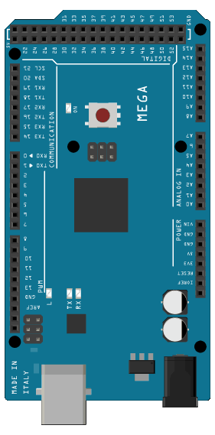
Hardware
USB
Power and ground
communications
Digital i/o
Notes:
ATmega1280

Slide 5
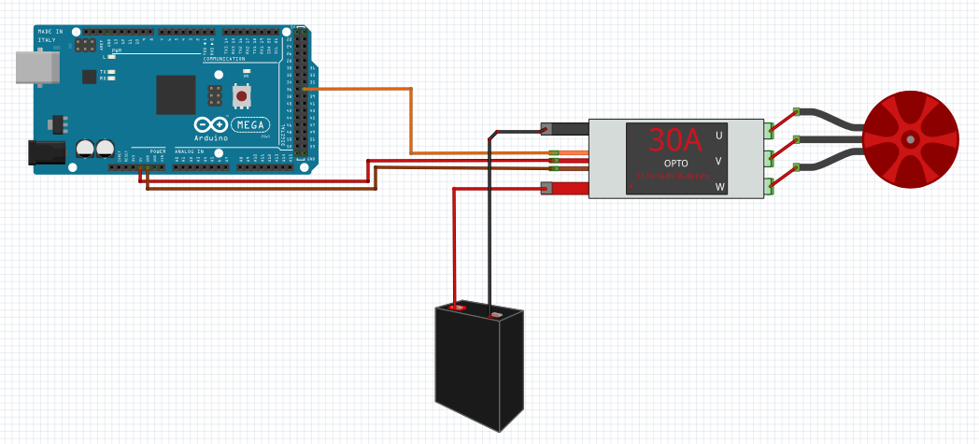
Wiring diagram

Slide 6
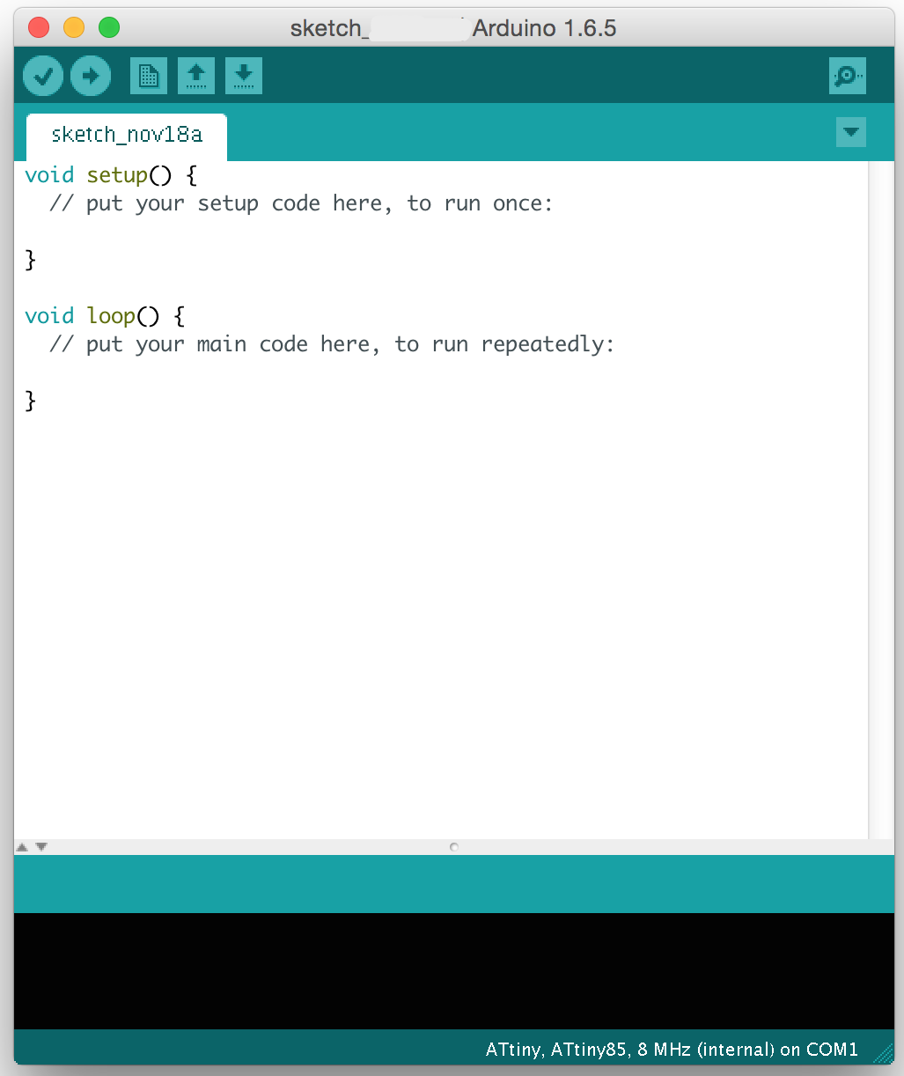
Software
Download Arduino IDE:
https://www.arduino.cc/en/software
The UNT Robotics Github:
https://github.com/untrobotics
Notes:
#include "Arduino.h"

Slide 7
“Engineers build things”
—some engineer

Slide 8
What you have learned:
You know the most important parts of your Arduino Mega
You can can read and follow a Wiring Diagram
You know your way around the Arduino IDE
You can read and write code for your Arduino Mega
You can properly wire, and control a Brushless Motor

Slide 9



UNT Robotics and Aerospace
MECHanical
Design and build the physical structure of the robot
electrical
Design and build the electrical components of the robot
software
Create Algorithms and programs the robot on how to carry out its objective and or intended purpose.

Slide 10

thanks
Does anyone have any questions?
untrobotics.com
github.com/untrobotics
UNT Robotics
@UNTRobotics
hello@untrobotics.com

